Slide 1
Tame the Beast!
Inventory Best Practices in ActionFlow

Slide 2
Agenda
Serialized Inventory (Slabs, Sinks)
Slab Processing Best Practices
Overview
Ordering Slabs
Slab usage estimation
Slab projection reports
SlabsmithAF (Slabsmith Integration)
Slab Reconciliation
Nonserialized Inventory (Brackets, tubes of adhesive, etc.)
Items that don’t have a serial number

Slide 3
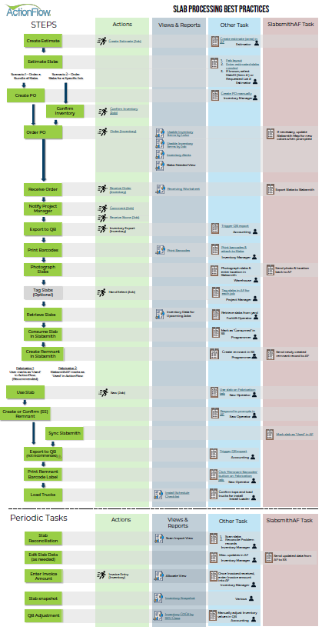
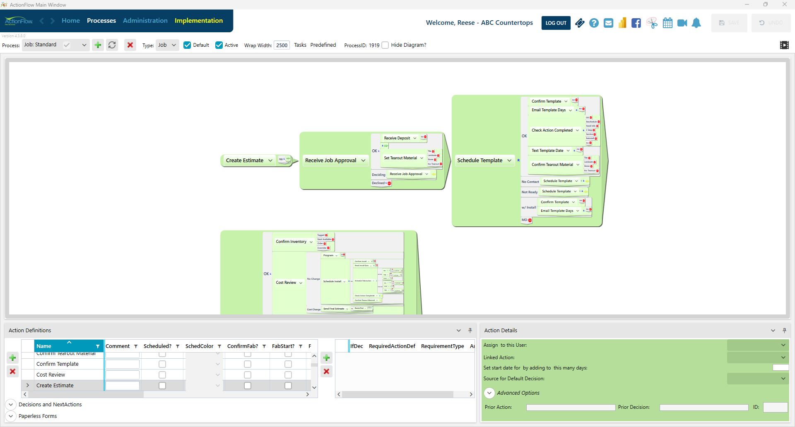
Best Practices Overview
Actions (Process):
Views & Reports:
Throughout ActionFlow
Other Tasks:
Tasks outside of ActionFlow, or just outside of Actions/Views/Reports
SlabsmithAF:
Tasks performed by the Slabsmith integration application
https://support.actionflow.net/slab-processing-best-practices

Slide 4
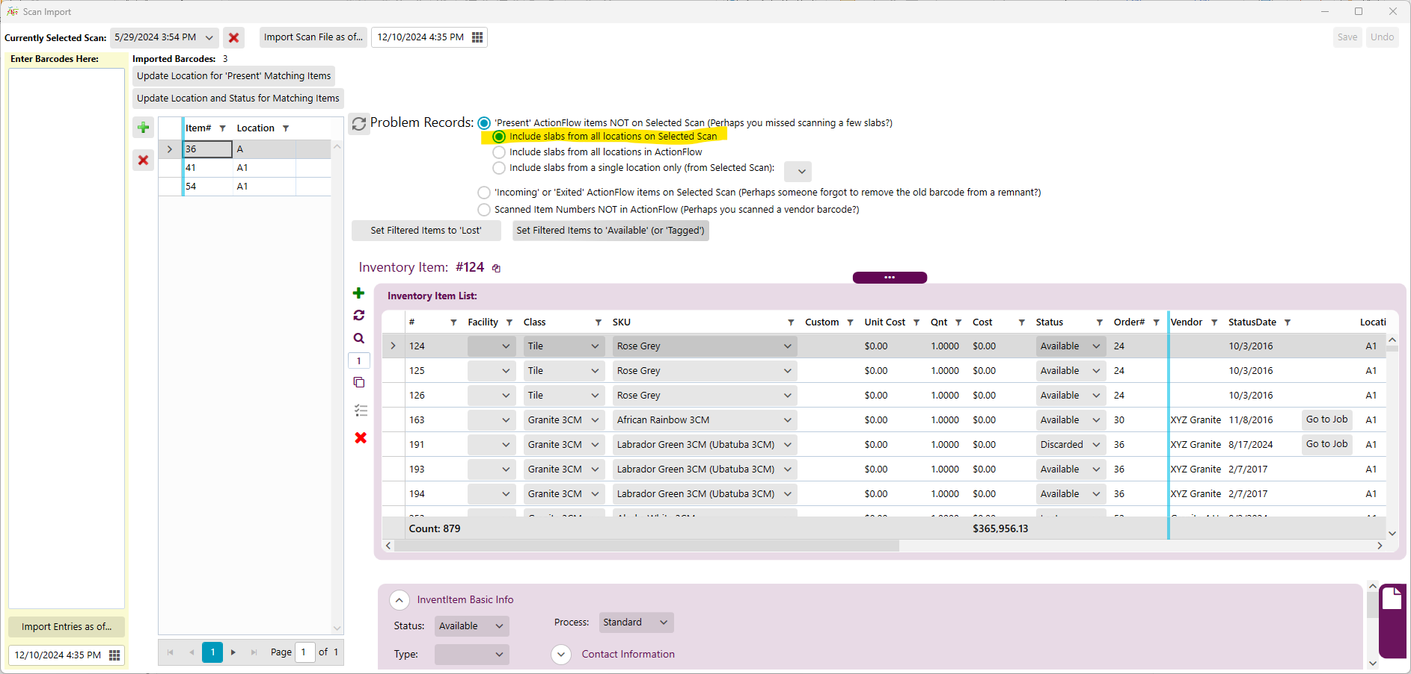
Scan Import

Slide 5
An Obvious Question
How do I order slabs?
Obvious, but not easy
It’s a beast of a question!
Crucial to the business of countertops

Slide 6
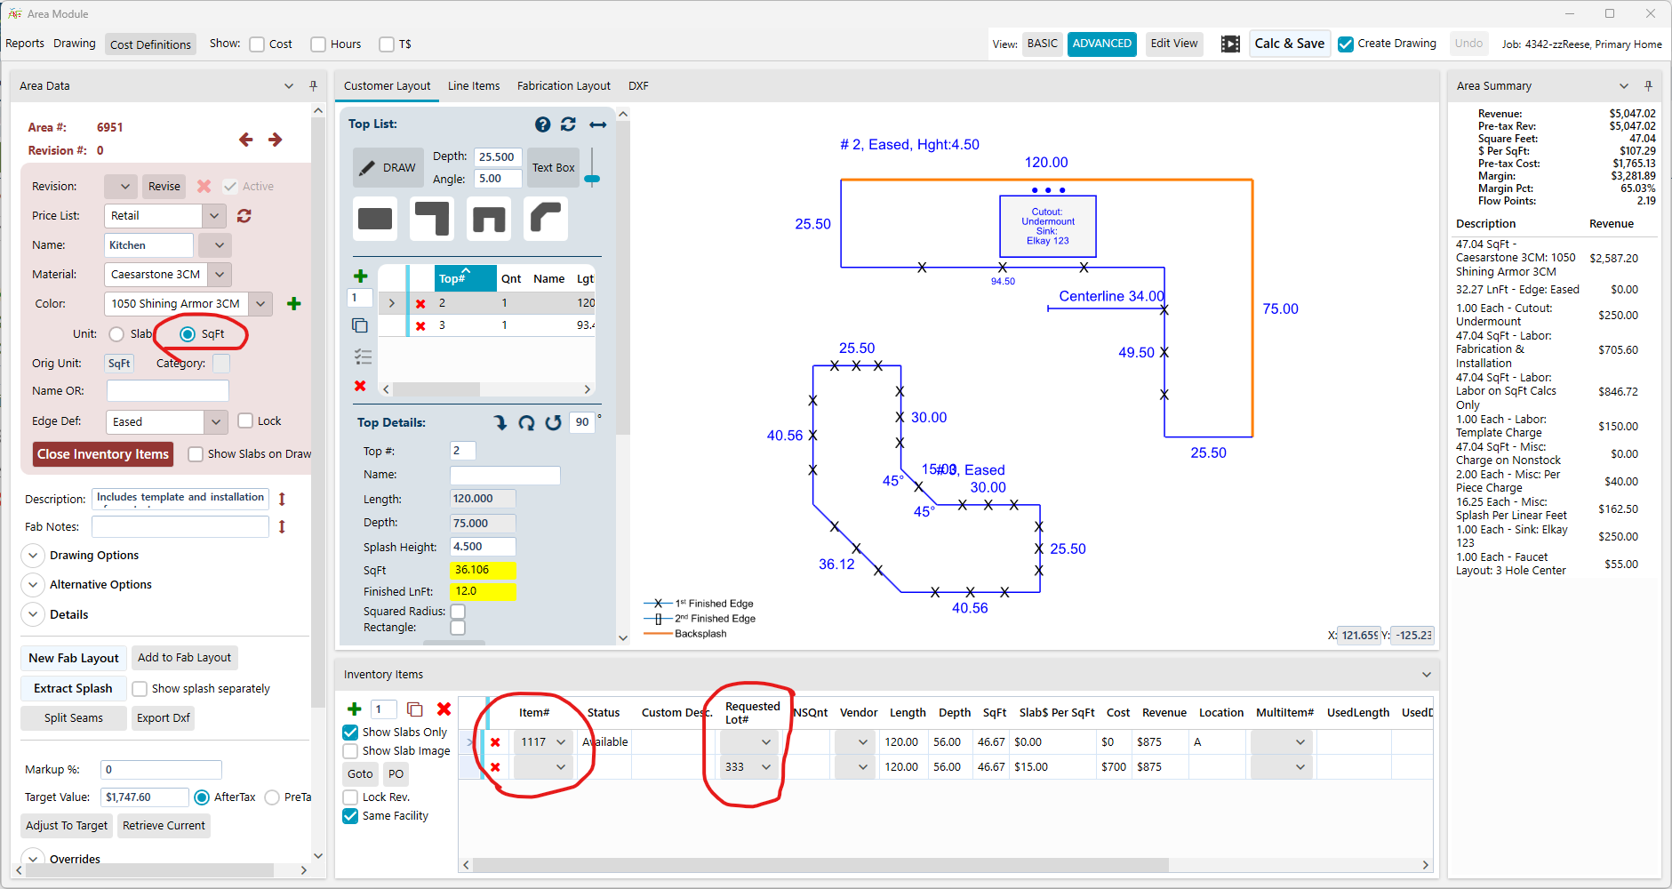
How do I order slabs?
Enter slabs needed for every job
If known, assign specific slabs
If known, assign Lot Number

Slide 7
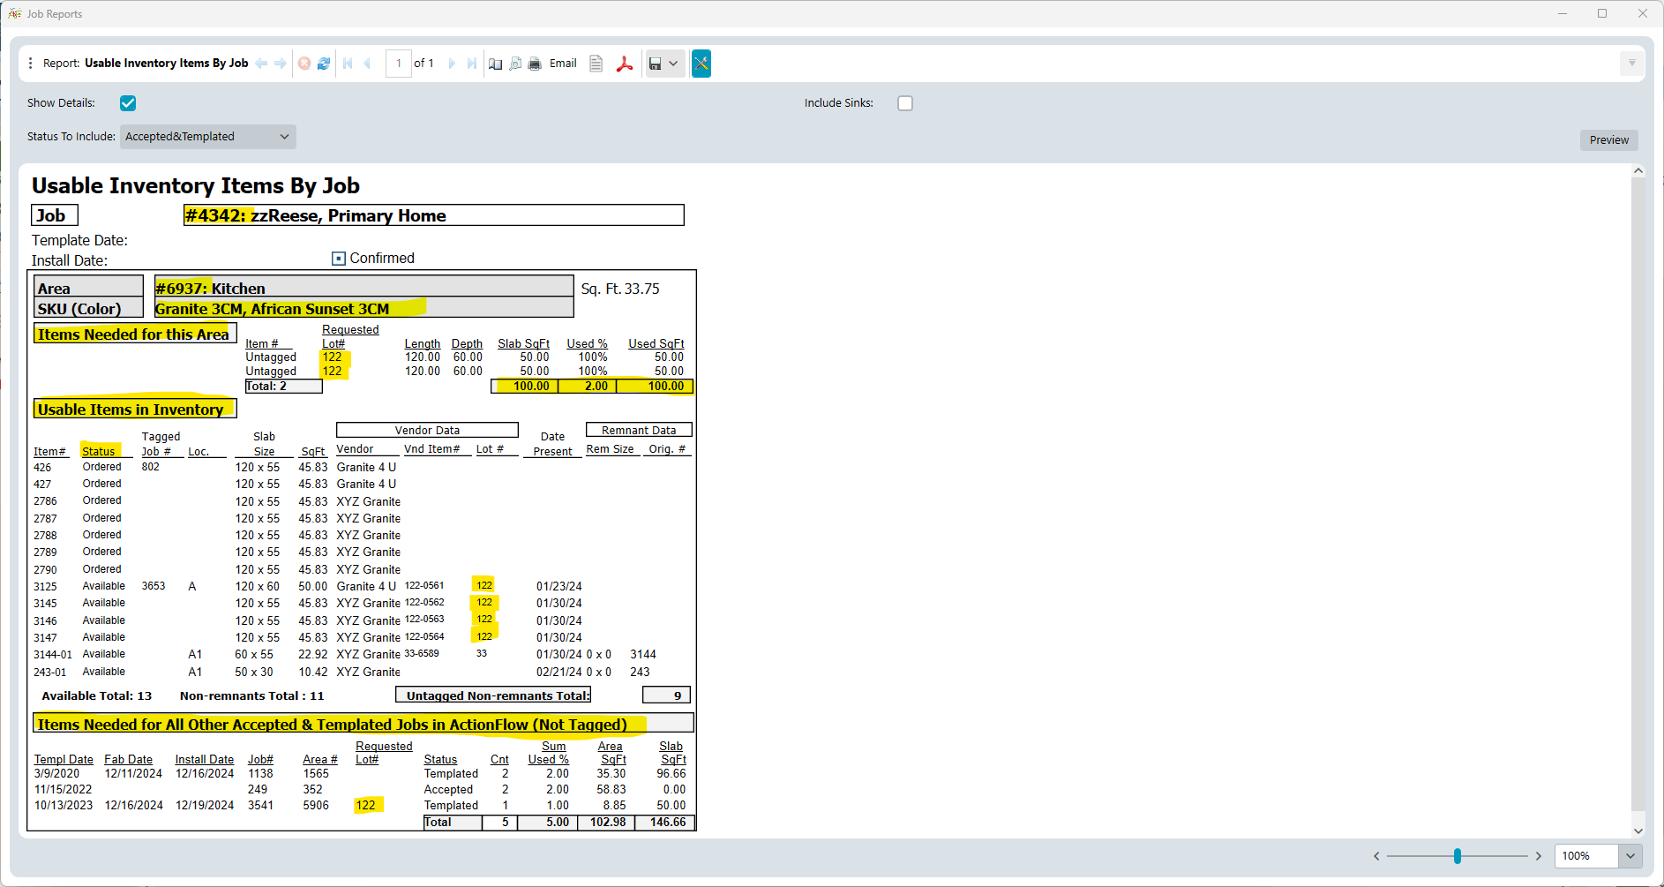
Usable Inventory Items By Job
!

Slide 8
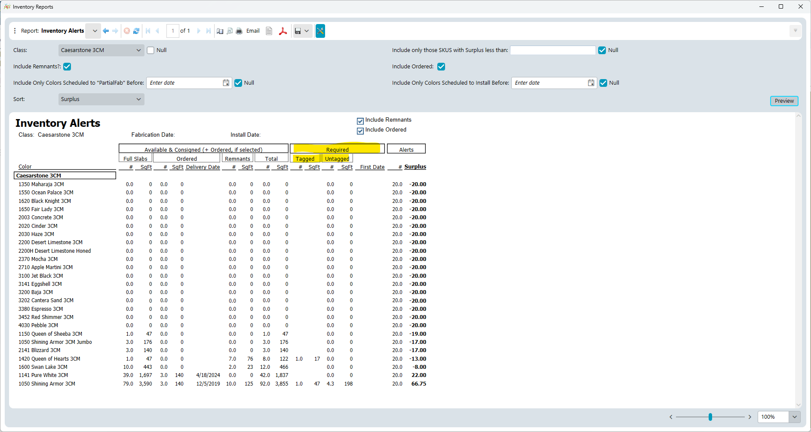
Inventory Alerts

Slide 9
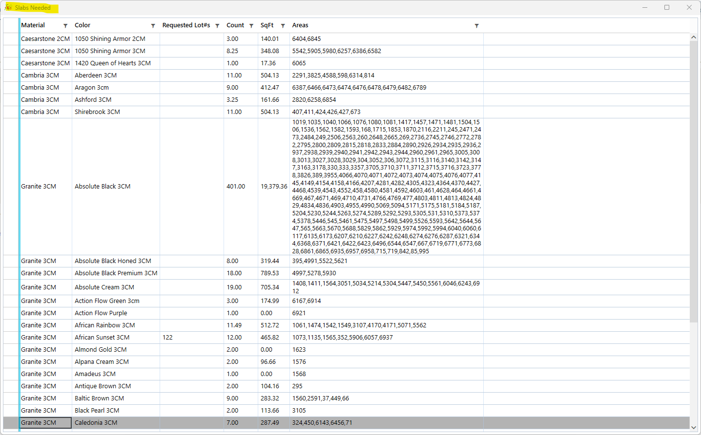
Slabs Needed View

Slide 10
Inventory Data for Upcoming Jobs (new version of ‘Upcoming Jobs with Inventory Data’)
Primary Goal: What slabs need to be ‘staged’?
Role: Forklift driver
Secondary Goal: Double-check that slabs are ready
Role: Inventory Manager
Warning: Not intended as primary ordering tool

Slide 11
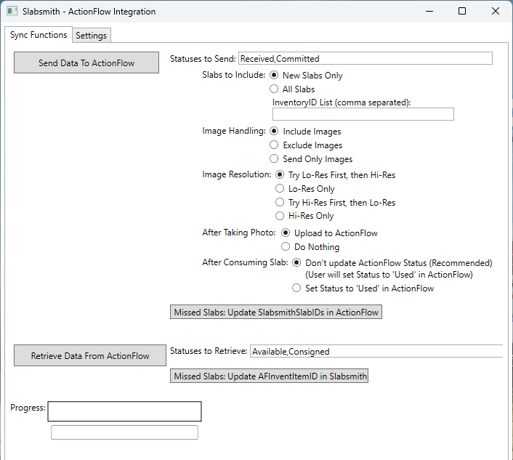
SlabsmithAF (Slabsmith Integration)

Slide 12
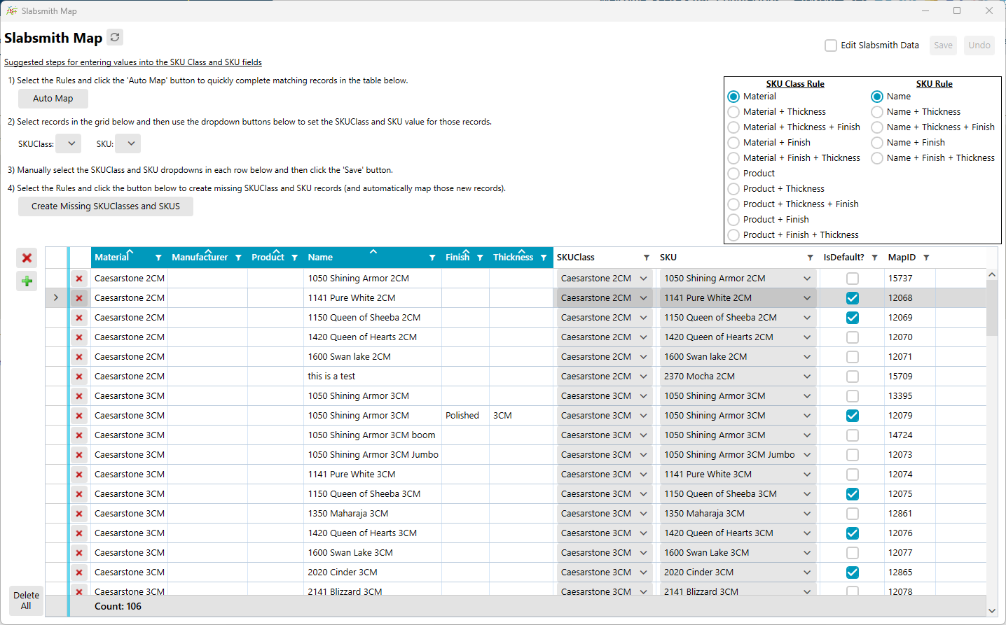
Slabsmith Map

Slide 13
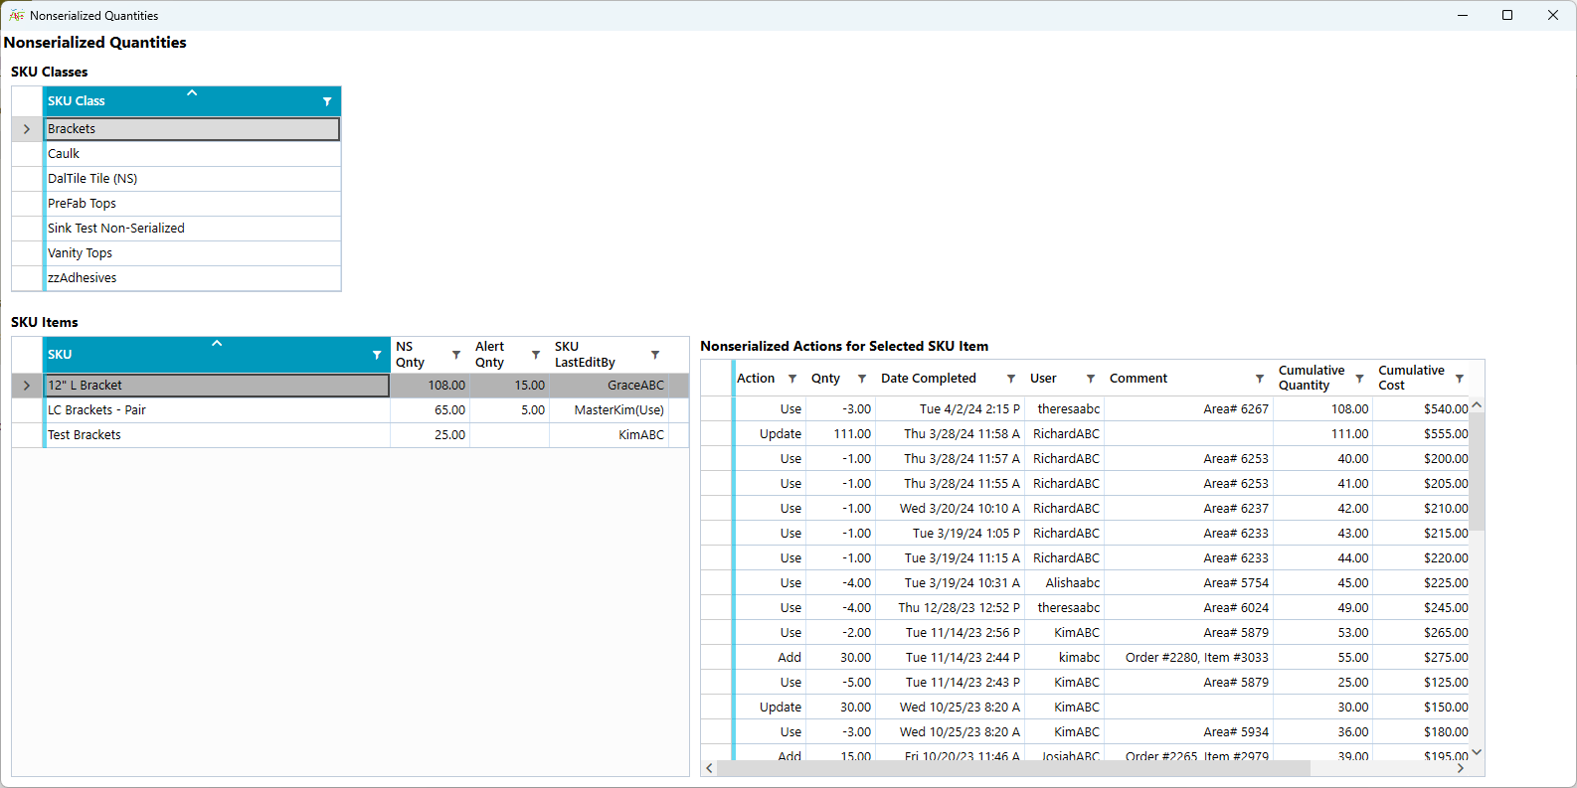
Nonserialized Inventory

Slide 14
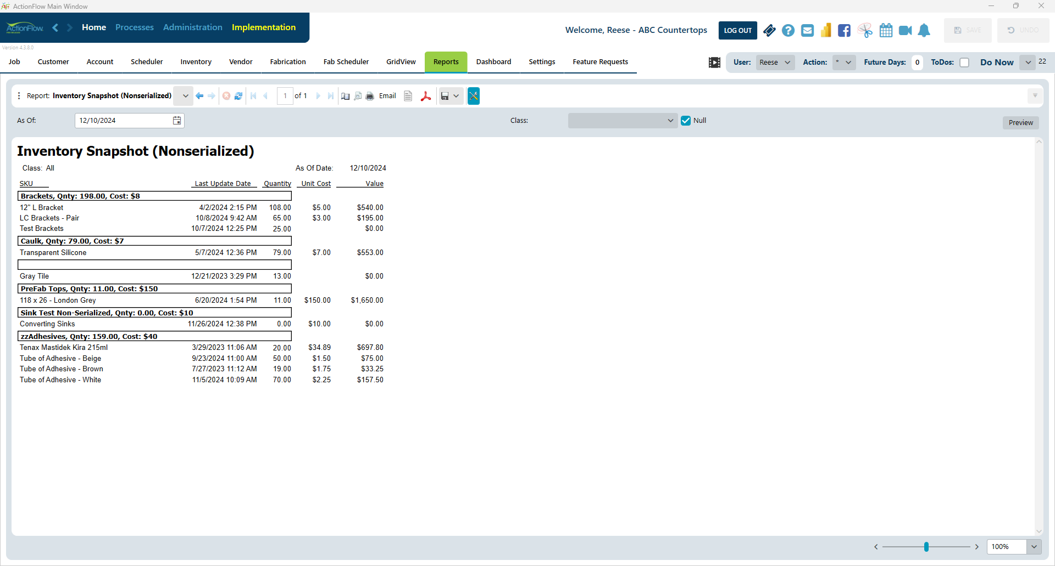
Nonserialized Snapshot

