Slide 1
Coming out of the Dark Organizing your shop with ActionFlow! Presented By: Chad Staheli Nov. 12, 2024
Notes:
One of the things I like most about ActionFlow

Slide 2
Topics Covered
Where is my job and what does it mean?
Job Status (driven by Action Progression)
Actions ~ Per department in shop
Action Decisions ~ Complete – Problem – Problem Material Needed
Problem Identification – Issue Category & Reason Code Tracking
Hourly Definitions
Reports

Slide 3
Where is my job?
Sales:
Production:
Management:
Finance:
Owners:
Notes:
3rd most asked question in a Countertop company – behind where is the sink and what are the faucet holes
Fear sales asking – What changed Where is that problem job - When are we getting paid for XX job How are we doing – volume through the shop

Slide 4
Job Status:
Created
Accepted
Templated
PartialFab (usually defined when the SAW Action is “done”)
Fabricated (usually defined when Polish/QC Action is “done”)
Partial Installed
Installed
Invoiced
Paid
Notes:
Life Cycle through the shop - Updated by completed shop action saw – Created – PartialFab Updated to Fabricated with completion of final Shop action
PartialFab – moves the job allocated Material into WIP (Work in Progress)
Fabricated – moves the job allocated Material into a Finished Goods Statis
These are financial reports and should be monitored and compared month over month
Time Lines Report

Slide 5
Actions for every area of the shop:
Notes:
Can/Should include all areas from post template – CAD/Engineering – Approvals – Slab Layouts and shop specific areas to the install - Can have calendar views for each or merged
Get as detailed as you want – Customizable to your shop and the way you work and how your jobs flow
Have their own calendar views!

Slide 6
Decisions for Shop Actions:
Notes:
Easily track the issues that are going on in the shop
The Issues Category and Reason report can summarize by Fabrication and then issues by incidence and by cost – If you will collect the information

Slide 7
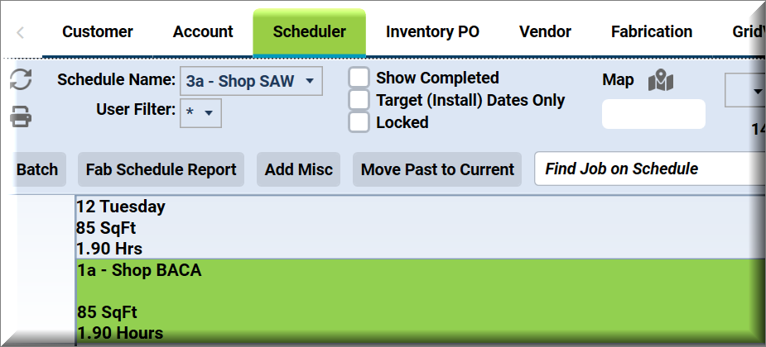
Hourly Definitions Calendar View

Slide 8
Hourly Definitions at Job Actions View

Slide 9
Reports: Issues Category and Reason
Notes:
How to set up and use this report was covered in a previous Webinar ~ Issues Tracking February 7, 2024 by Roderick Bley of Fabricators Choice

Slide 10
Reports: WIP ~ Work In Progress
Notes:
WIP Report AS of 10/31 There were 212 Units of Inventory 6846 sqft Value $116,291
WIP is a snap shot report – usually pulled at end of month

Slide 11
Reports: Timelines
Notes:
Next one of my favorite things ActionFlow can do – Hourly Definistion

